Slide 1
Total Quality Management
C011 Arushi Sangle C044 Amishi Desai C049 Chahel Gupta
C039 Kshitij Sawant C040 Rahil Jethwa C053 Milberg Noronha

Slide 2
Total Quality Management (TQM) is a management approach aimed at continuously improving the quality of products, services, and processes within an organization.

Slide 3
Meaning of TQM
It focuses on continuous improvement of processes, products, and services to achieve customer satisfaction.- It emphasizes teamwork, employee involvement, and a systematic approach to problem-solving.
TQM originated in the manufacturing sector but has since been adopted across various industries including healthcare, education, and services.
Key principles of TQM include: 1. Customer focus 2. Process improvement 3. Involvement of all employees in quality initiatives

Slide 4
Importance of TQM
TQM is crucial for organizations striving for long-term success and sustainability.
It ensures that organizations meet or exceed customer expectations, resulting in enhanced customer satisfaction and loyalty.
TQM fosters a culture of continuous improvement, innovation, and employee empowerment, leading to higher efficiency and productivity.
By minimizing defects, errors, and waste, TQM helps organizations reduce costs and improve profitability.

Slide 5
Advantages of TQM
1
Delivers stronger, higher quality products to customers
4
Enables a company to become more adaptable
2
Results in lower company-wide costs
5
Strengthened competitive position
3
Minimizes waste throughout the entire production and sale process
6
Adaptability to changing or emerging market conditions and to environmental and other government regulations

Slide 6
Advantages of TQM
7
Higher productivity
10
Reduced costs and better cost management
8
Enhanced market image
11
Improved customer focus, satisfaction and employee morale
9
Elimination of defects and waste
12
Increased customer loyalty, retention and job security

Slide 7
Why do we need TQM ?
Enhances customer satisfaction
Optimizes processes
Engages employees
Fosters continuous improvement
Reduces errors
Improves reputation
Supports data-driven decisions
Ensures compliance with standards
Achieves higher efficiency and productivity
Increases customer loyalty
Provides a competitive advantage in the market

Slide 8
01
CASE STUDY: TOYOTA

Slide 9
IMPLEMENTATION OF TQM IN TOYOTA
Extended management responsibility beyond immediate products and services
Examined consumer usage patterns to develop and enhance products
Focused on minimizing procedural impacts through optimization
Emphasized kaizen (continuous process improvement) for measurable, repeatable, and visible procedures

Slide 10
KEY PRINCIPLES OF TOYOTA'S TQM APPROACH
CUSTOMER-ORIENTED ATTITUDE
INNOCATION THROUGH IMPROVEMENT
SELF-DISCIPLINE AND TOTAL OPTIMIZATION
Instills a culture of self-discipline among employees
Promotes rigorous quality standards and strategic planning
Utilizes resources efficiently for total optimization across operations
Prioritizes meeting and exceeding customer expectations
Ensures customer satisfaction by prioritizing needs and interests
Emphasizes continuous improvement and innovation
Aims for optimal quality and efficiency in manufacturing processes

Slide 11
02
CASE STUDY : Ramaiah Institute of Management Studies (RIMS)

Slide 12
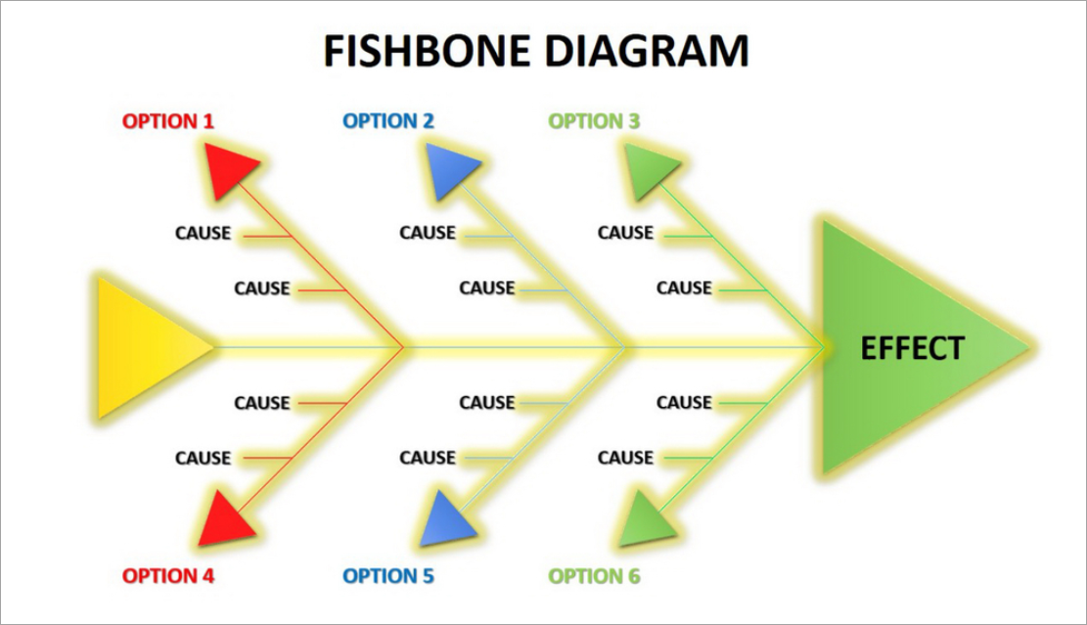
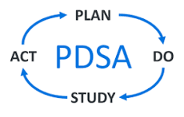
IMPLEMENTATION OF TQM IN RIMS
Led by Chief Academic Advisor Dr. Krishnamurthy
Volunteer team audited, analyzed, and implemented process changes
Focused on three key dimensions: assurance of learning, research and productivity, and quality of placements
Faculty underwent extensive training in quality auditing skills, continuous improvement tools, and the 'plan-do-study-act' cycle

Slide 13
Results and Impact of TQM at RIMS
Test scores increased by 9% post-TQM implementation
Number of recruiters hiring from RIMS increased by 22%
Average salary offered to graduates increased by $20,000 along with Placement revenue rose by $50,000
RIMS gained recognition and climbed up domestic and international education tables along with a surge in the number of top 100 businesses recruiting from the school

Slide 14
Key Strategies
Enhanced communication with stakeholders.
Incorporation of case studies into the curriculum
Mandate for students to be certified in English by the British Council

Slide 15
Project Outcomes and Next Steps
Outcomes: Improved product/service quality, increased efficiency, cost savings, enhanced employee morale, and strengthened reputation.
Lessons Learned: Importance of leadership commitment, effective communication, continuous monitoring, and employee training.
Next Steps: Continued monitoring and refinement, ongoing training, expansion of quality improvement efforts.

Slide 16
Total Quality Management as a Cultural Phenomenon
Evolution from quality control to business-level management
Expansion of Scope
Customer-Centric Approach
Employee Involvement
The Importance of ISO 9000 Standards in Promoting Quality Practices
Global Standardization
Continuous Improvement
Customer Confidence

Slide 17
Total Quality Management as a Cultural Phenomenon
Edgar Schein's model of organizational culture
Basic Assumptions
Core Concepts
Management Areas
Practices
TQM studied as a cultural phenomenon within this framework
Cultural Alignment
Behavior Integration
Leadership Role

Slide 18
Total Quality Management as a Cultural Phenomenon
Managerial decision-making process
Rational Approach
Clear Objectives
Context-Independent Information
Nature of an organization as a key assumption
Continuous Improvement Culture
Proactive Adaption

Slide 19
Conclusion
Customer-Centric Excellence
Empowered Workforce
Continuous Innovation
Cost-Efficiency and Profitability
Competitive Edge
Total Quality Management serves as a cornerstone for organizational excellence.
By prioritizing customer satisfaction, fostering employee engagement, and promoting innovation, organizations can achieve sustainable growth, competitive advantage, and unparalleled success.

Slide 20
Thank You

